Slide 1


Green Pace
Security Policy Presentation
Developer: Nicholas Glover

Slide 2

OVERVIEW: DEFENSE IN DEPTH
This security policy was established to uphold the practice of defense-in-depth
It will protect the system through multiple strategies

Slide 3
THREATS MATRIX
Likely Vulnerabilities that have a high chance of occurring STD-003-CPP STD-004-CPP STD-005-CPP STD-007-CPP STD-008-CPP STD-009-CPP STD-010-CPP | Priority Vulnerabilities that present a large threat STD-003-CPP STD-004-CPP STD-005-CPP STD-008-CPP STD-010-CPP
Low priority Vulnerabilities that present a small threat STD-001-CPP STD-002-CPP STD-006-CPP STD-007-CPP STD-009-CPP | Unlikely Vulnerabilities that have a low chance of occurring STD-001-CPP STD-002-CPP STD-006-CPP
Static code analysis tools can be used to find these vulnerabilities

Slide 4
10 PRINCIPLES
Validate Input Data
STD-002-CPP | STD-003-CPP | STD-004-CPP
Heed Compiler Warnings
STD-001-CPP | STD-002-CPP | STD-003-CPP
STD-004-CPP | STD-005-CPP | STD-007-CPP
STD-008-CPP | STD-009-CPP | STD-010-CPP
Architect and Design for Security Policies
STD-003-CPP | STD-006-CPP | STD-007-CPP
STD-008-CPP | STD-010-CPP |
Keep It Simple
STD-006-CPP |
Default Deny
Adhere to the Principle of Least Privilege
Sanitize Data Sent to Other Systems
STD-002-CPP | STD-003-CPP | STD-004-CPP
Practice Defense-in-Depth
STD-005-CPP | STD-007-CPP | STD-008-CPP
Use Effective Quality Assurance Techniques
STD-001-CPP | STD-002-CPP | STD-003-CPP
STD-005-CPP | STD-006-CPP | STD-010-CPP
Adopt a Secure Coding Standard
STD-001-CPP | STD-002-CPP | STD-003-CPP
STD-004-CPP | STD-005-CPP | STD-006-CPP
STD-007-CPP | STD-008-CPP | STD-009-CPP
STD-010-CPP |

Slide 5
CODING STANDARDS
[STD-003-CPP] – String Correctness: Guarantee strings have sufficient storage space
[STD-004-CPP] – SQL Injection: Exclude user input from format strings
[STD-005-CPP] – Memory Protection: Do not access freed memory
[STD-008-CPP] – Expressions: Do not access an object outside its lifetime
[STD-010-CPP] – Miscellaneous: Value-returning functions must return a value from all exit paths
[STD-009-CPP] – Object-Oriented Programming: Copy operations must not mutate the source object
[STD-002-CPP] – Data Value: Do not cast to an out-of-range enumeration value
[STD-007-CPP] – Exceptions: Handle all exceptions
[STD-001-CPP] – Data Type: Never qualify a reference type with const or volatile
[STD-006-CPP] – Assertions: Use a static assertion to test the value of a constant expression

Slide 6
ENCRYPTION POLICIES
Encryption in Rest – Refers to the encryption of the storage location
Encryption at Flight – Refers to the encryption of the data as it’s transferred
Encryption in Use – Refers to the constant security of the data

Slide 7
TRIPLE-A POLICIES
Authentication – Who is at the door?
Authorization – What can the guest do?
Accounting – What did the guest do, and when?

Slide 8
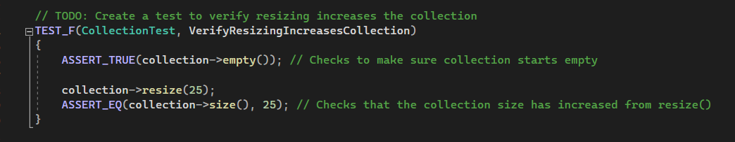
Unit Testing: Verify Resizing Increases Collection
This positive unit test verifies that the resize() function properly increases the size of the collection.
Code for the unit test
Results of the unit test

Slide 9
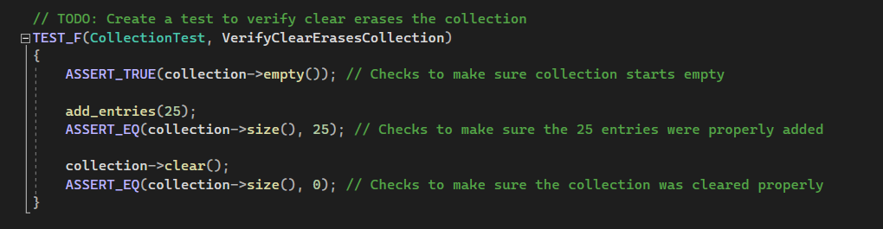
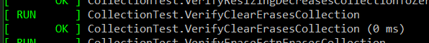
Unit Testing: Verify Clear Erases Collection
This positive unit test verifies that the clear() function properly erases the collection.
Code for the unit test
Results for the unit test

Slide 10
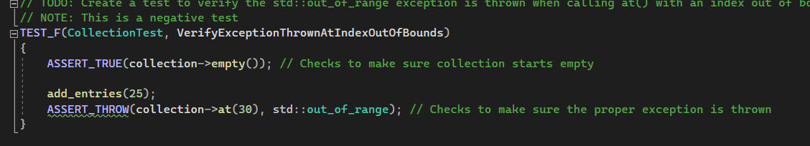
Unit Testing: Verify Exception Thrown At Index Out Of Bounds
This negative unit test makes sure the proper Index Out Of Bounds Exception is thrown when the collection is accessed at an index beyond its size.
Code for the unit test
Results for the unit test

Slide 11
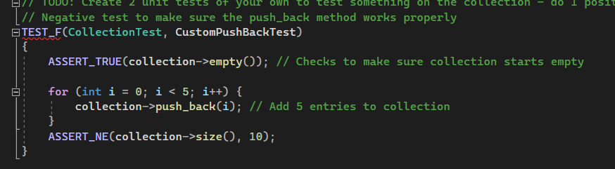
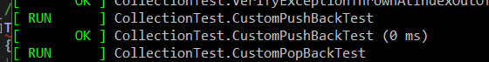
Unit Testing: Custom Pushback Test
This negative unit test checks to make sure that the proper element is pushed back into the collection.
Code for the unit test
Results for the unit test

Slide 12

AUTOMATION SUMMARY

Slide 13
TOOLS
Compiler
CppChecker
Static code analysis tool

Slide 14
RISKS AND BENEFITS
There is always a risk to changing a system
Waiting means less cost
Waiting means the system is less secure for longer
Updating the system security will have up front costs
The system will become much more secure quicker

Slide 15
RECOMMENDATIONS
Threats to security are constantly evolving
Security must evolve with it
The security policies must be kept up to date

Slide 16
CONCLUSIONS
All standards should be implemented
Defense-in-Depth is the most effective strategy to secure a system
The policies must be kept up to date

Slide 17
REFERENCES
Dunham, R. (2021, October 26). The importance of a company information security policy. Linford & Company LLP. https://linfordco.com/blog/information-security-policies/
Google. (2023, August 11). DevOps Tech: Shifting left on security. Google. https://cloud.google.com/architecture/devops/devops-tech-shifting-left-on-security
Murray, A. (2020, June 13). Secure coding: A practical guide. Mend.io. https://www.mend.io/blog/secure-coding/
Mylonas, L. (2018, November 27). What is AAA Security? an introduction to authentication, Authorisation and Accounting. Codebots. https://codebots.com/application-security/aaa-security-an-introduction-to-authentication-authorisation-accounting
Seacord, R. C. (20130323). Secure Coding in C and C++, 2nd Edition. [[VitalSource Bookshelf version]]. Retrieved from vbk://9780132981972
Sei cert C++ coding standard. SEI CERT C++ Coding Standard - SEI CERT C++ Coding Standard - Confluence. (n.d.). https://wiki.sei.cmu.edu/confluence/pages/viewpage.action?pageId=88046682
Vijayan, J. (2022, November 16). 6 devsecops best practices: Automate early and often. TechBeacon. https://techbeacon.com/security/6-devsecops-best-practices-automate-early-often

